Slide 1


Teams Training
Bringing it all together with Teams
Ways to use Teams
Navigating Microsoft Teams
Creating a new team
An introduction to Microsoft 365 Groups

Slide 2
















Bringing it all together with Teams
Teams acts as a hub, (kind of like creating a group chat in Google creating areas to showcase different apps as and when they are needed
Hub
Communication
Productivity
Collaboration
Innovation

Slide 3

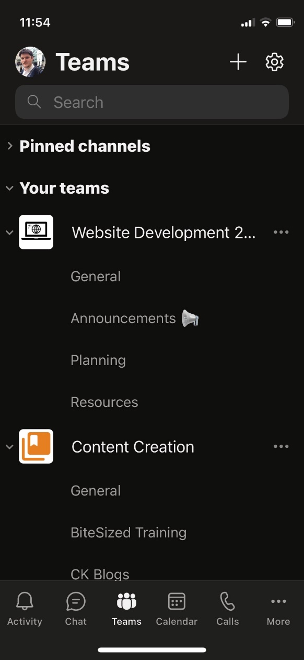

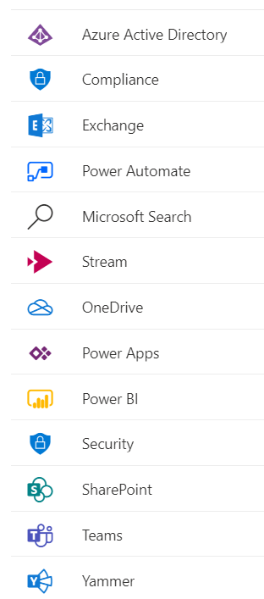









Ways to use Teams
Application
Mobile app
Browser
All options require an internet connection

Slide 4
Logging Into Microsoft Teams
Pharmapacks has a special login for those using Teams/M365 (most office workers have a Teams license)
username@entouragecommerce.onmicrosoft.com
Your 365 password
With your Microsoft 365 license, you can install all office products in a maximum of FIVE devices , which includes Excel, PowerPoint, Word, and more
You can…
Use Teams from the browser or your Mobile Phone
OR
Install Teams on your Desktop
OR
Both! - (Your Preference)

Slide 5
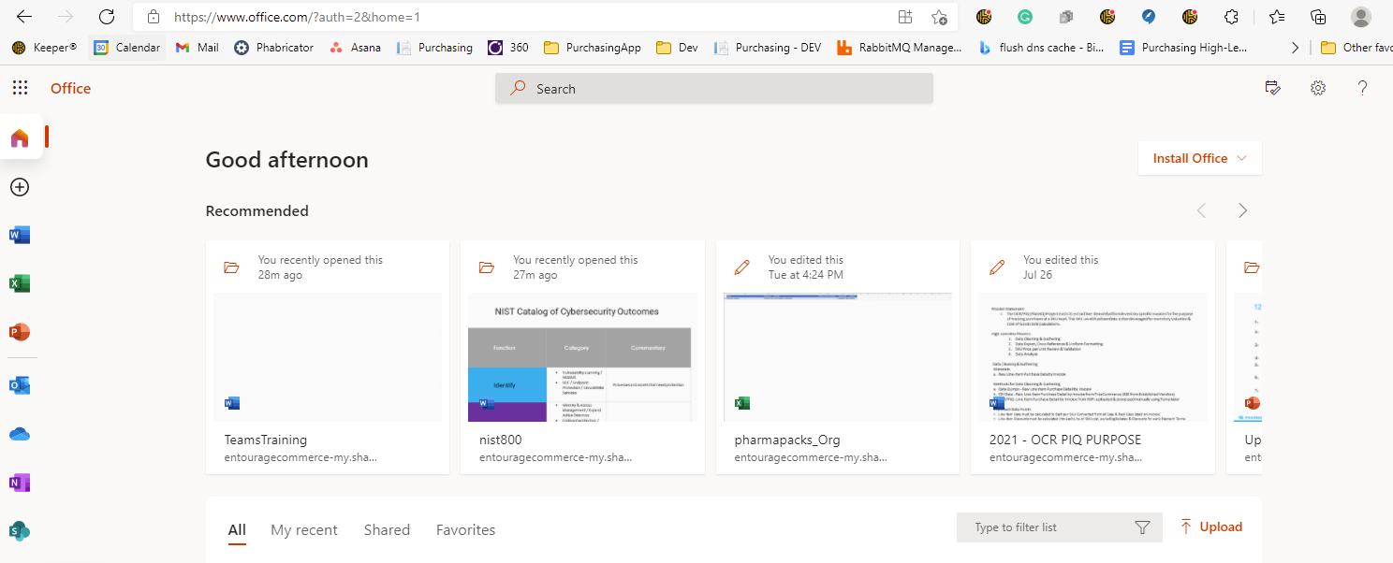
Hands On Lab: Log Into M365 Portal
Everyone go to: portal.microsoft.com
Log into the portal with your entourage user name and password (username@entouragecommerce.onmicrosoft.com)
Type in your password
See the Microsoft Office Home Page

Slide 6

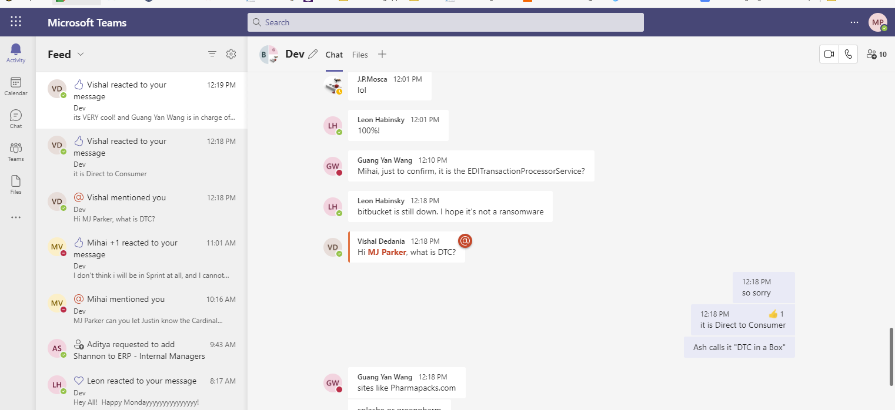
Hands On Lab: Continued
Click on the Teams Icon to the left
See the Teams Home Page:
Click on the Navigation
Bar to the left
Notice my LOGIN Initials:

Slide 7

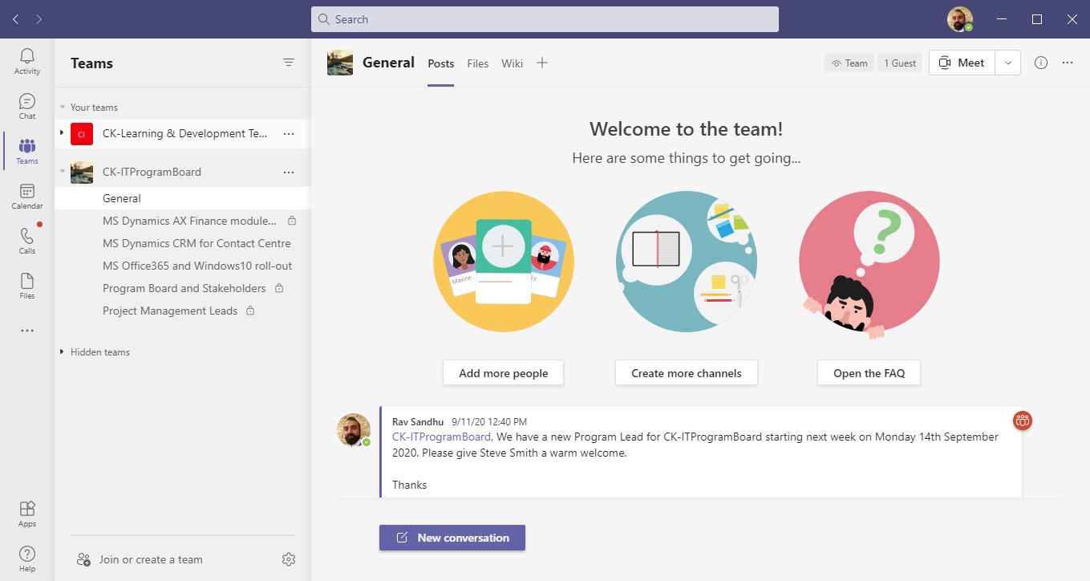

Navigating Microsoft Teams
Search people files channels and more
Settings, tenant & status
Activity – see replies, mentions and likes
Tabs
Chat – have private chats,1-2-1, group or video
Team and channels
Teams – access collaborative workspaces
Calendar – view and schedule meetings
Calls – Make audio and video calls
Files – Quick access to files and OneDrive
More – access additional apps
Start a new conversation
Join or create a teams

Slide 8
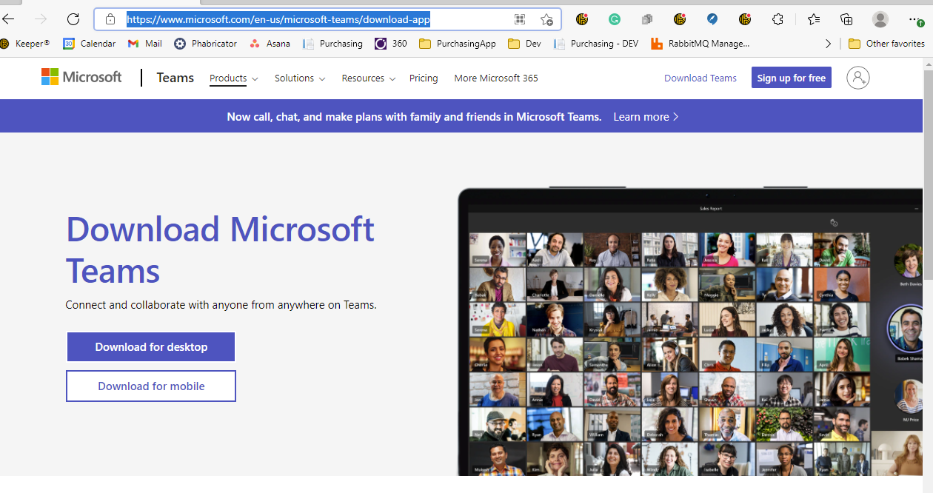
But we can also install Teams (optional):
Sometimes easier than having another browser open to keep track of
Allows you to have more settings to control (such as notification sounds, etc.)
Everyone will receive a copy of this slideshow (which will include the download link) for this training
https://www.microsoft.com/en-us/microsoft-teams/download-app
Then, you just log into desktop teams or mobile teams the same way you log into the browser version:
username@entouragecommerce.onmicrsoft.com
password

Slide 9
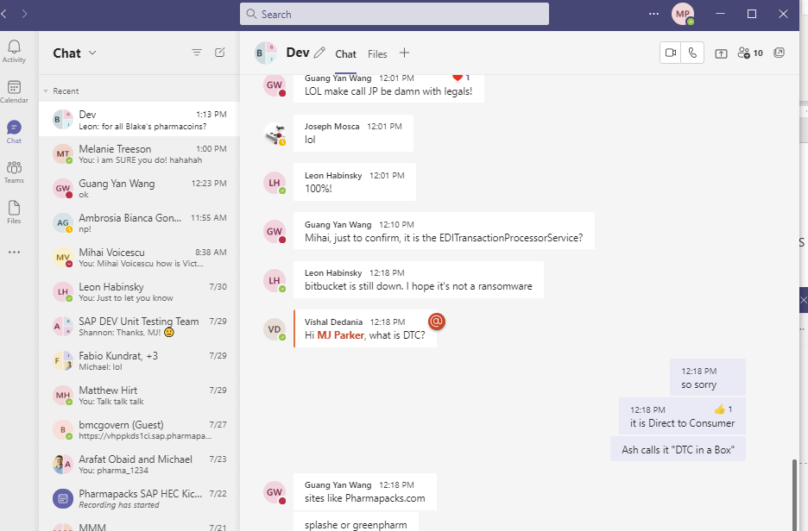
Demo: Teams looks like this installed:
Note: You can search for Teams from your
Windows search box:

Slide 10
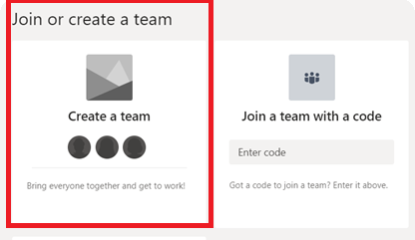
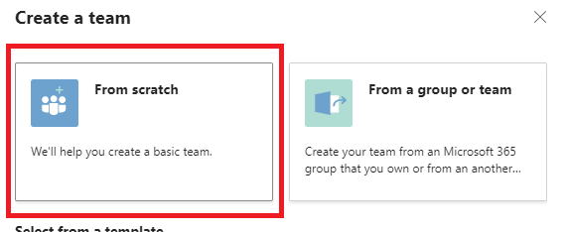
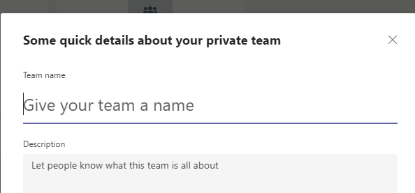
Creating a new team
Am I allowed to create new Teams in my organizations?
At Pharmapacks, you are allowed to create new teams AND you can add other Pharmapacks Folks.
The only thing you cannot do, is add EXTERNAL Folks to your team.
To add an external user, you must put an Asana ticket in and Aditya will have to add the user (all part of our going Public safety and strategy)
STEP 1
STEP 2
STEP 3

Slide 11
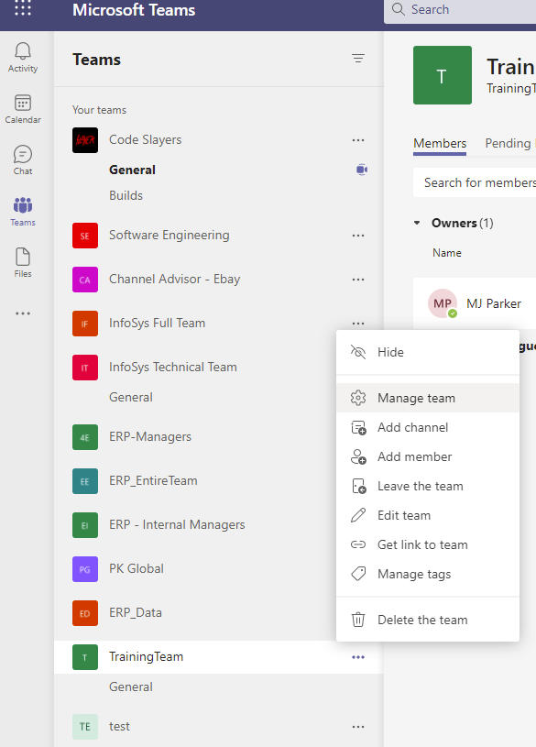
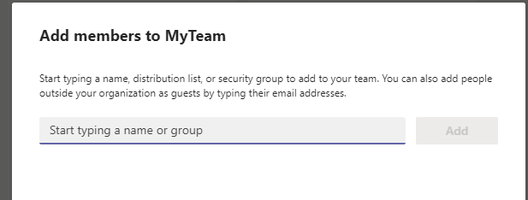
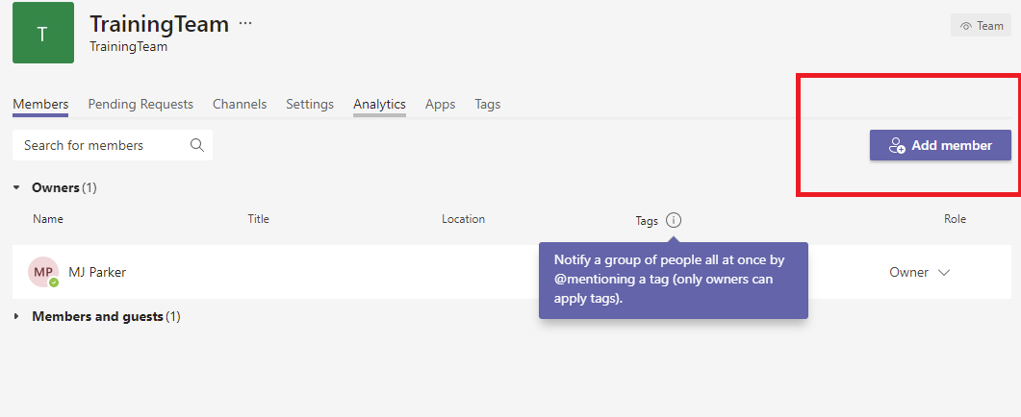
Then, Add Members!
Add Members anytime after the team is created:
Right Click the Team
Choose Manage Team
Add Members
Add Members when you create the team

Slide 12
Chatting, Meetings, and Files
Chatting
Meetings
Files (including GIFS, and Emoticons)

Slide 13


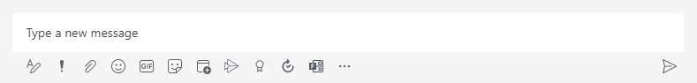
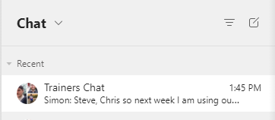
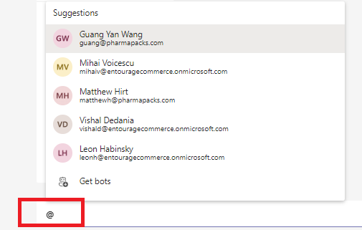
Chatting
To all Team Members
Chat with entire Team
Chat with specific people
Chat with more than one person (called a group)
To Specific Team Members – Type the @ symbol and then start typing their name. Select them off the list

Slide 14
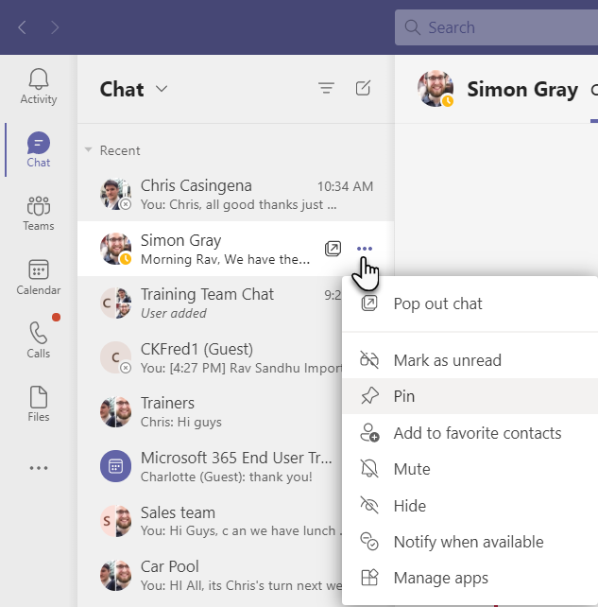
Organize chats
Pin Chats so they are always at the top of the list
Mute chats to turn off notification
Notify when available to set a status change notification
Hide Chat and Unhide

Slide 15
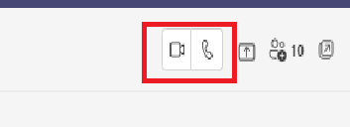
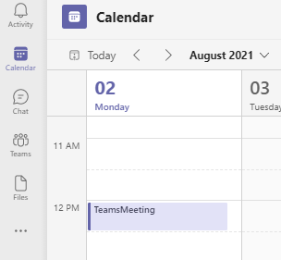
Meetings
Impromptu Meeting
Adding Meetings/Meetings in Progress
NOTE: Teams/Outlook – Not used by Pharmapacks (yet)

Slide 16
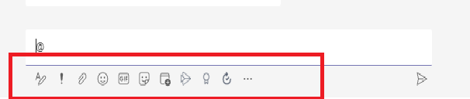
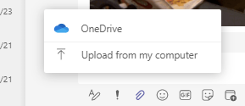
Files, GIFS, Emoticons
You can use the bottom of the chat window to send Files, GIFS, Emoticons
When adding a file, you can get it from your computer, or from (One Drive) – Microsoft’s store all like Google Drive
Once the File is attached, you can use the enter key to send to one (or more people). Everyone can open and collaborate on the file (if that is the access you desire)

Slide 17
Summary – Teams Training
Logging into the portal with your M365 Entourage Account
Creating Teams
Chatting in Teams
Creating and Joining Meetings
Working with Files, GIFS, and Emoticons
Any Questions?

